Slide 1

VDDHH WEB Training

Slide 2
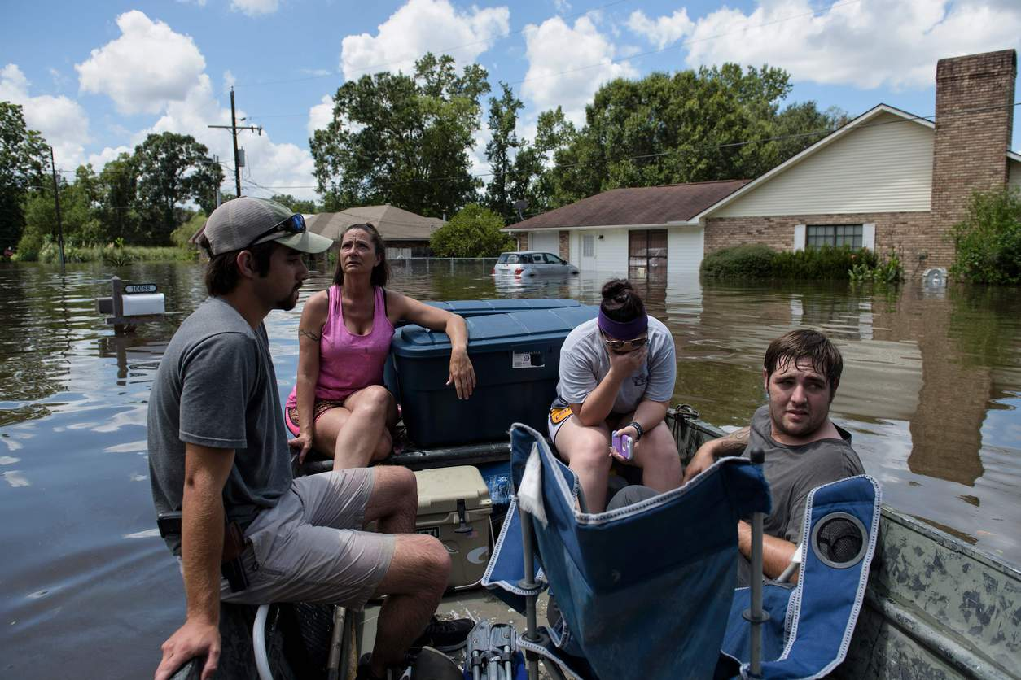
Are YOU Ready?
Emergency and Disaster Preparedness

Slide 3
This presentation has been prepared for the VDDHH Website.

Slide 4
EMERGENCIES and DISASTERS
They happened in the past.
They could happen today.
They WILL happen in the future.
Notes:
We may not know WHEN, but at some point, severe weather will occur. Some severe weather has little to no warning time; other event are predictable, with days to prepare. If you do not have an emergency kit, NOW is the time to get the most basic items together into a bag / container / suitcase. More about what is needed later.

Slide 5
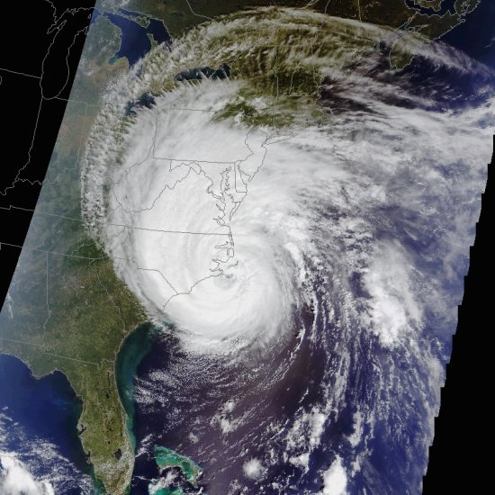
Image of
Hurricane Isabel in 2003
Notes:
Hurricanes are not surprises . We know weeks in advance that a hurricane has formed, but likely only have a few days to know WHERE it will make landfall. If the GENERAL direction is towards the US coastline, you need to get prepared. Living 200+ miles from the coast does NOT mean you don’t need to plan for the hurricane.

Slide 6
Common hazards in Virginia
These will vary somewhat depending
upon which part of the state you live.
Some of these hazards are:

Slide 7
We must prepare for…
Hurricanes / Tornadoes
Flash Floods / Flooding
Chemical spills
Highway
Rail
Wildfires
Winter Storms
Notes:
Hurricanes and tornadoes tend to be seasonal, meaning most occur during a specific time of the year. Virginia’s tornado “season” is April 1 through June 30, and Hurricane “season” is considered to be June 1 – November 30 of each year. Note that June is part of both seasons.
Flash floods occur when rain falls faster than it can runoff, and can happen is areas miles from the oceanfront or rivers.
Chemical spills occur on highways (trucks AND cars can contain Hazardous Materials) and train tracks.

Slide 8
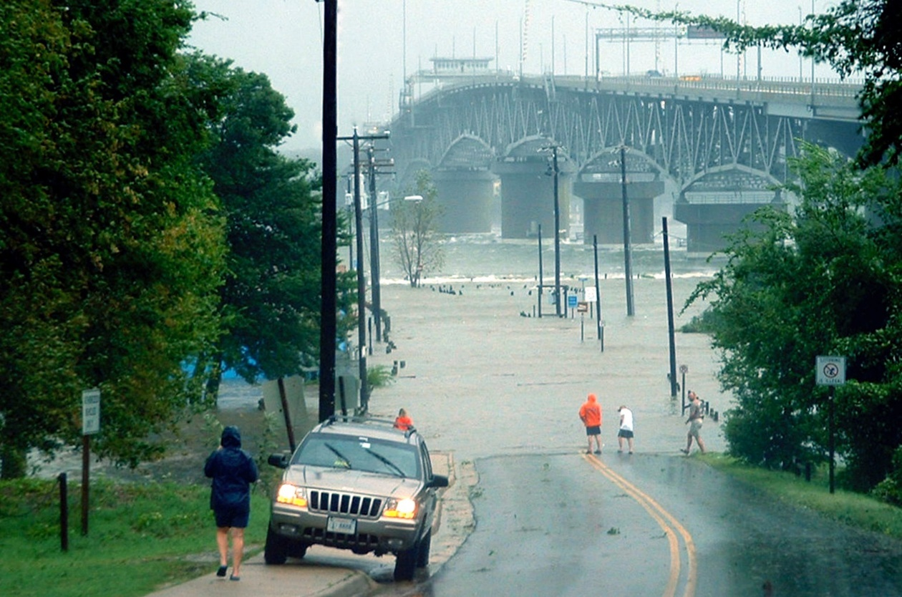
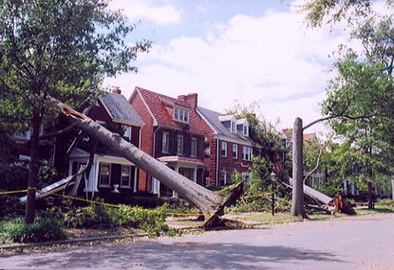
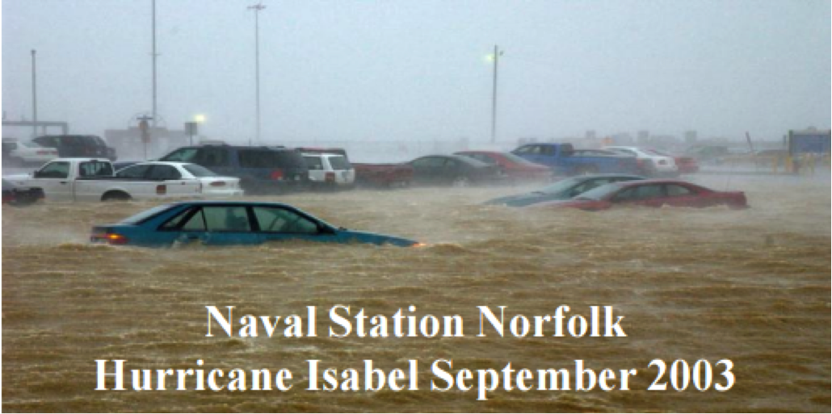
Damage in Virginia

Slide 9
General Emergency Preparedness
This means things you need to do NOW to prepare for any type of emergency.

Slide 10
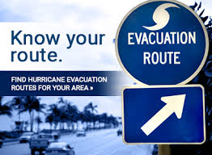
Shelter and Evacuation Concerns
How will you get out?
Drive yourself?
Para-transit?
Friends / family?

Slide 11
This family wasn’t prepared
YOU must take the responsibility for your family’s safety

Slide 12
Some of the concerns already being addressed include:
Warning and Notification
Communication Access
Interpreters for shelters and news conferences
In-Shelter Communications
Service Animals

Slide 13
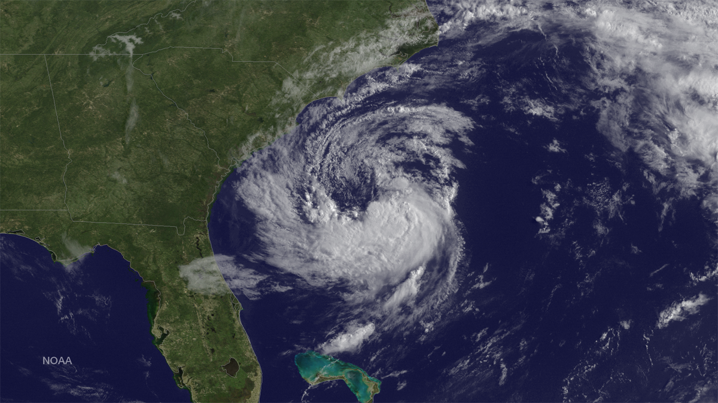
The 2018 Hurricane season is June 1 – Oct 30

Slide 14
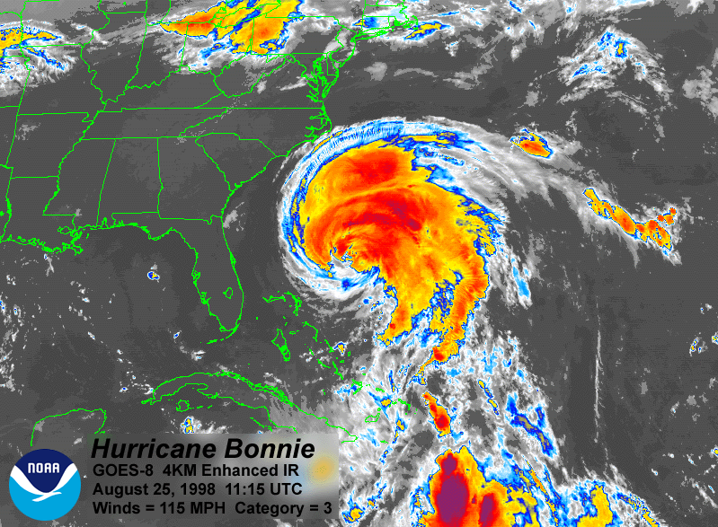
1. WARNING times
Hurricanes are not surprises
We have warnings – often days ahead of the impact phase

Slide 15
2. They can affect huge areas of land and sea
These are not local disasters, but can impact hundreds or thousands of square miles and numerous states at the same time.

Slide 16
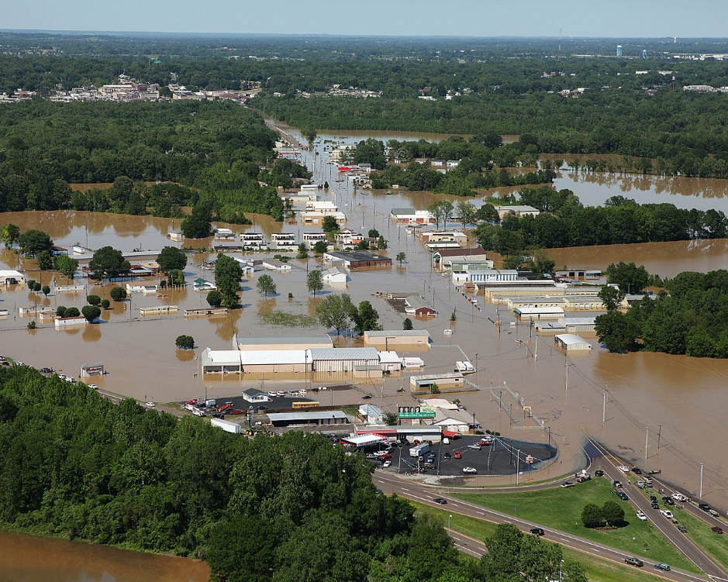
3. Other events can occur because of the storm
Widespread flooding
Tornadoes
Damaged homes,
neighborhoods, and
businesses

Slide 17
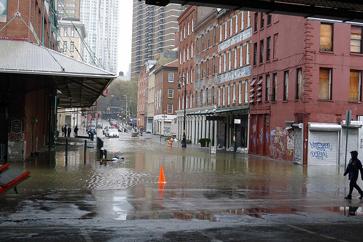
4. Economic Impact
Hurricanes can destroy the economic base of one – or many – communities, and affect the lives of THOUSANDS of people and families.

Slide 18
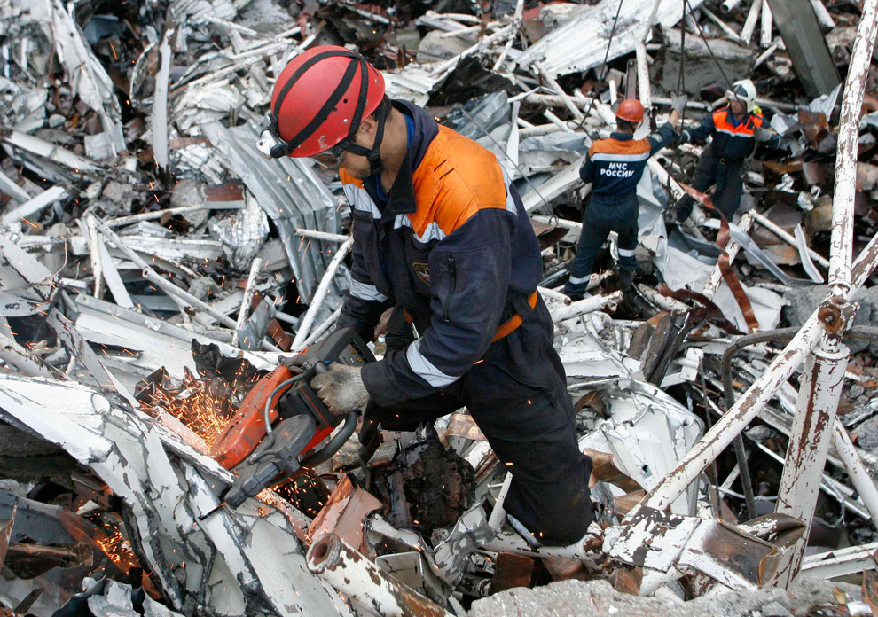
5. Infra-structure damage
Roads, bridges, power lines, and water treatment systems may all be severely damaged or destroyed in a hurricane.

Slide 19

6. Recovery Time
Full recovery from a major hurricane may take YEARS.

Slide 20
Hurricanes are not the only threat
Winter Storms may also present unique challenges to our normal routines. Like hurricanes, they are not “surprises” and offer some lead and some preparation time.
But, many people do not heed the warning.

Slide 21
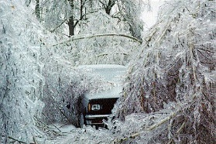
Winter Storm Damage
They can disrupt electricity, transportation, and businesses.

Slide 22
People die because they think
“It can’t happen to ME”.
GET READY!

Slide 23
TORNADO
The season for Tornados is, basically, SPRING:
MARCH – APRIL – MAY
But they can and do occur in every month of the year.

Slide 24
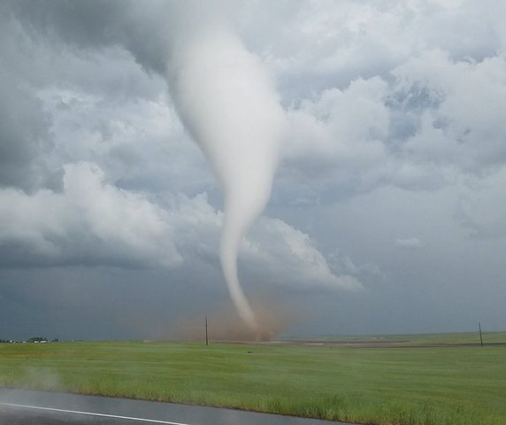
Tornadoes
Occur during severe thunderstorms
May occur with very little warning
Can be small or HUGE

Slide 25
MAKE A PLAN
You may need to rely on your OWN resources for at least several days.
Bottom line:
Your safety and well-being is your hands.

Slide 26
Your safety – Your responsibility
In a widespread situation, you may need to rely on your OWN resources for at least several days.
Bottom line:
Your safety and well-being is your hands.

Slide 27
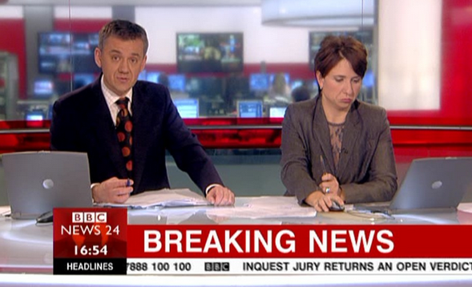
Warning and Notifications
How do YOU receive warnings?
Text or email message alerts?
TV or Radio news bulletins?
Friends or family?

Slide 28
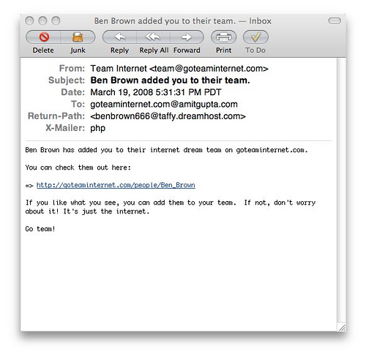
Many of us rely on Email or Text alerts
Do you subscribe to a reliable weather service?
In a widespread power outage, how will you keep your phone charged?

Slide 29
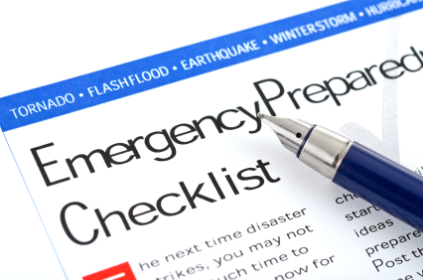
Make a Plan
For yourself
For your Family

Slide 30
Warning
How will you receive the warning?
Check in with local 9-1-1 Center
Tell them your needs for communication and alerting
Contact LOCAL Emergency Management Office

Slide 31
How can you find your family?
Meeting Place
Near Home
Away from Home
Establish CONTACT POINTS in case you are separated from family

Slide 32
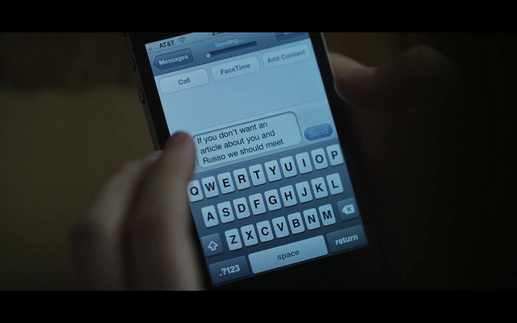
CONTACT POINT
Use a Telephone / Text number of a family member or friend who lives away from the local area.
Serves as a common “check in” point for all family members if separated during crisis period. Keep contact information current.

Slide 33
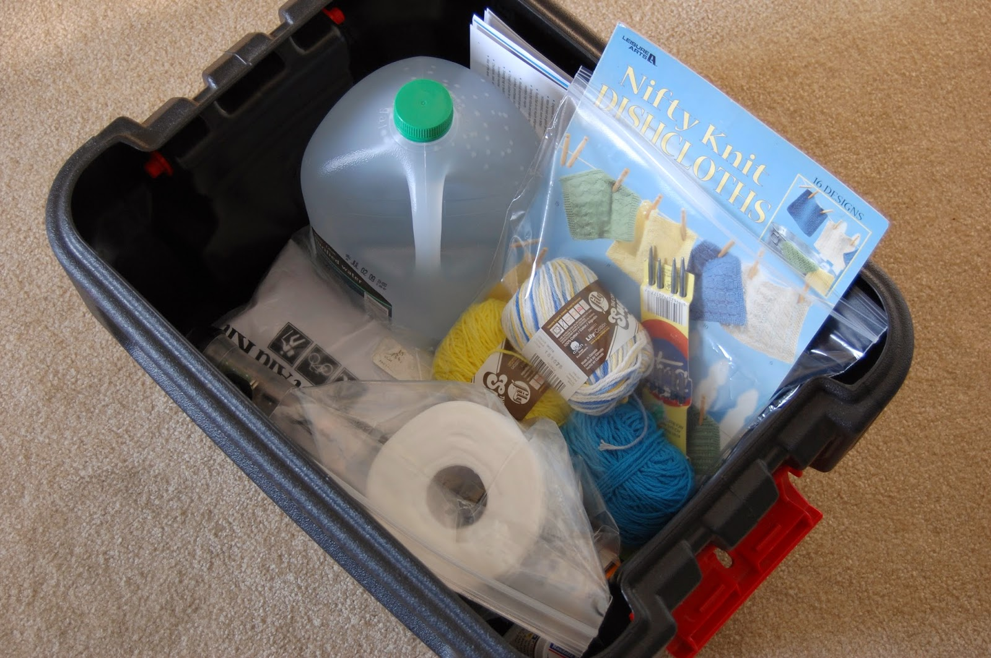
READY TO GO “ Kit
“What you need depends upon YOUR needs.
Different challenges require different supplies, but there are some basics…

Slide 34
Some “To-Go” Kit items:
Flashlights / Batteries / Chargers and cords
Drinking Water (1 gal per person/day)
Medicines / Prescriptions
First Aid Kit
Portable Radio / TV (Caption-capable)
Non-perishable Foods

Slide 35
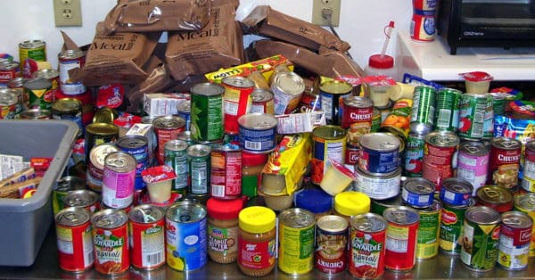
More items:
Can openers
Paper plates / bowls
utensils / scissors / knives
Paper / cloth towels
Disinfectants / Lysol
Waterless hand soap
Trash bags
Toilet Paper

Slide 36
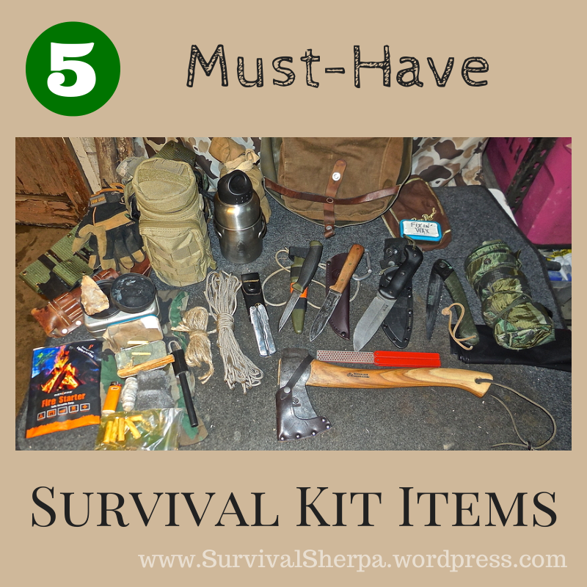
Still more… (it’s a big kit)
Disinfectants / Water Treatment
Bedding (blankets, pillows)
Extra seasonal clothing
Cash $$$$
Gloves (latex and work gloves)
Shoes

Slide 37
Other supplies
OTC medicines / Vitamins
Post cards / stamps
Pens / pencils / Note Cards / Notebooks / Books / Games
List of Important phone / contact numbers & email addresses

Slide 38
Shelter-In-Place
The “To-Go” Kit could be your Stay-Home Kit if for some reason you are unable to evacuate to a shelter or other housing.
You will need the same supplies for at least 3 days.
Roads could be impassable and electricity could be out.

Slide 39
Sheltering In-Place
If you have an outdoor grill, be sure that you have plenty of propane.
Kerosene heaters made for indoors with plenty of fuel.
Cook perishable foods first.

Slide 40
For those with food concerns or allergies
Gathering your own foods may be a better option than pre-packaged meals.
Suggested: V-8 juice
Dried fruits
Shelf-stable milk
Canned tuna or chicken
Canned baked beans

Slide 41
Keep your supplies fresh
Rotate Emergency supplies with fresh supplies.
Rotate fresh batteries for flashlights, hearing aids, etc…
Don’t forget CHARGERS.

Slide 42
There will be a LOT of time to fill….
Whether at home without electricity, or in a shelter, life without our usual entertainment can become boring very quickly.
Interesting books, games, puzzles, etc… can go a long way to keeping yourself – and children – occupied. Check Goodwill and Thrift stores.

Slide 43
Keep these phone numbers in your kit:
Keep these phone numbers in a safe place
Local Utilities
Doctors
Pharmacy
Bank / Credit Union Account numbers

Slide 44
Your special needs are your responsibility
If you have specialized needs, be sure you have enough.
If wheelchair dependent, have tire repair kit, heavy gloves, and extra batteries / charger.
Insulin / needles
Oxygen – keep a good supply on hand

Slide 45
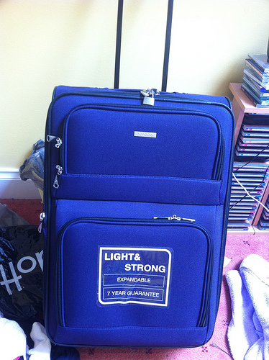
Where to keep your supplies
A good place to store these items is an old suitcase with wheels or plastic bins.
Look for them at thrift stores and Goodwill.

Slide 46
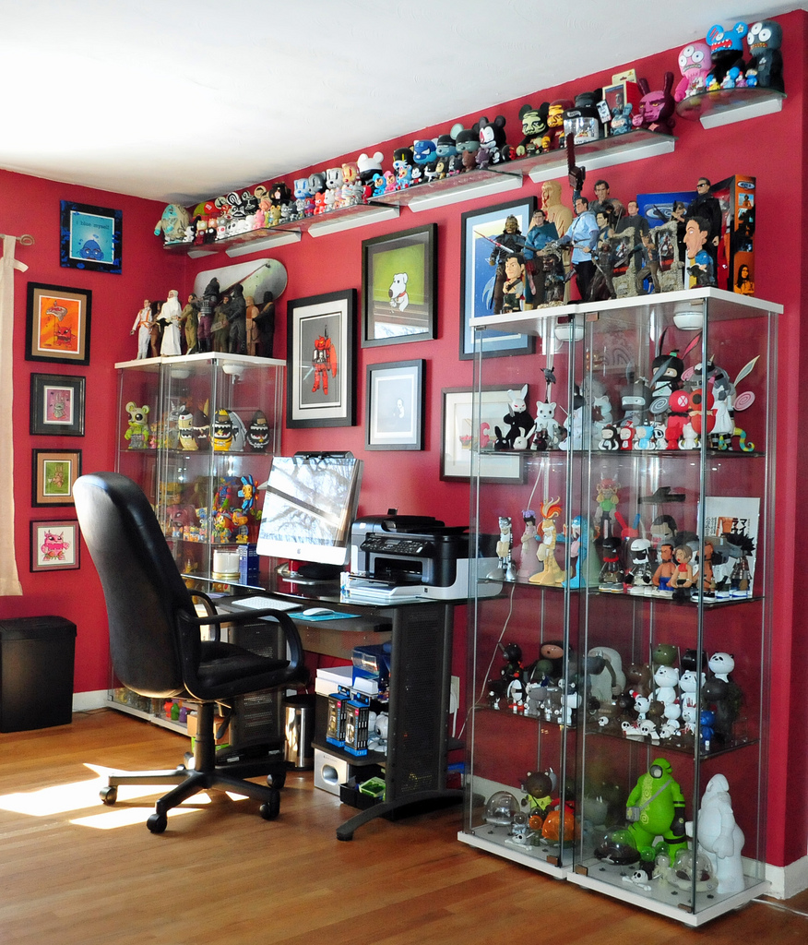
Insurance papers and documentation
Do you have photos of your home’s contents in a safe place – for insurance purposes?
When did you last update your homeowner’s insurance?

Slide 47

Take Pictures of your home every year
A quick way to inventory your home is to stand in the center of each room and take a photo of each wall. Then, create a file, and send the file to yourself and to your emergency contact.

Slide 48
Things to think about…

Slide 49
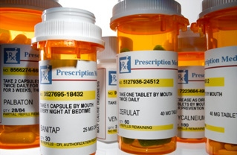
Information about medicines
You should also have your medical service providers and pharmacy numbers quickly available.
Copies of your prescriptions or photos of the labels will also be helpful.

Slide 50
Keep supplies for service animals and pets
Dry Pet Food
Water
Bedding / Crates
Leashes / Harnesses / Collar / ID tags
Pet Medical Records

Slide 51
Be Aware and PREPARE
During certain “seasons”, the probability increases, so be prepared.
Planning ahead just might save your life.
Notes:
Introduction
Barriers
VDDHH and the Deaf Community
Law + Funding + Programs = Access
Washington Scenarios

Slide 52
For more information, check out these websites
  https://www.vaemergency.gov
  https://ready.gov
  https://community.fema.gov/connect.ti/READYNPM
  http://www.accessibleemergencyinfo.com/
Notes:
Introduction
Barriers
VDDHH and the Deaf Community
Law + Funding + Programs = Access
Washington Scenarios

Slide 53

Questions? Comments?
Gary Talley
Community Services Manager
804-325-1289
gary.talley@vddhh.Virginia.gov

Slide 54
END
Notes:
Introduction
Barriers
VDDHH and the Deaf Community
Law + Funding + Programs = Access
Washington Scenarios

